Slide 1
.NET Core Workshop
Mariano Sánchez
sanchezmariano@outlook.com @marianosz
http://weblogs.asp.net/marianos

Slide 2
.NET: the family gets bigger
.NET FRAMEWORK
.NET CORE
XAMARIN
Platform for .NET applications on Windows
Cross-platform and open source framework optimized for modern app needs and developer workflows
Cross-platform and open source Mono-based runtime for iOS, OS X, and Android devices
Distributed with Windows
Distributed with app
Distributed with app
Notes:
Notes: Focus on the great additions to the .NET Framework, enabling developers to target the latest applications in the cloud and devices. Explain the distribution mechanism of each. .NET Framework is distributed and available on Windows whereas .NET Core & Xamarin are distributed with the app.

Slide 3
Languages
C#
Flexible, powerful, multi-purpose
Investments in C# 7: Evolve for modern patterns in distributed applications: tuples, pattern matching, others.
VB
Simple, easy to use
Investments in VB 15: Bring key language features and platforms while keeping VB simplicity principles.
F#
Elegant functional programming
Investments in .NET Core: Language updates for C# 7 / VB 15 interop, platform support and tooling updates.
Notes:
C#, Visual Basic and F# are all supported on .NET Core and can be used to create cross-platform apps that run anywhere. In addition, C# is supported in other cross-platform editors like Visual Studio Code via OmniSharp. Currently there are project templates provided C# in Visual Studio and Visual Basic templates will be added as the tooling reaches RTM (with Visual Studio NEXT).

Slide 4
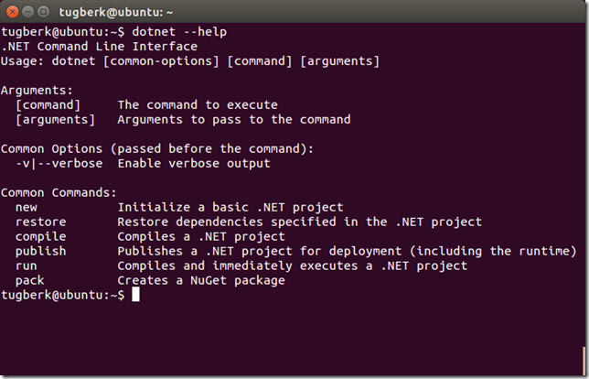
.NET Command Line Interface (CLI)
A single tool for compiling, deploying, and managing .NET applications on all platforms
Notes:
The .NET Execution Environment (DNX) is a software development kit (SDK) and runtime environment that has everything you need to build and run .NET applications for Windows, Mac and Linux. It provides a host process, CLR hosting logic and managed entry point discovery. DNX was built for running cross-platform ASP.NET Web applications, but it can run other types of .NET applications, too, such as cross-platform console apps

Slide 5



Development Tools
Visual Studio 2017
Visual Studio
Visual Studio Code
Visual Studio Code
Other editors: Sublime Text, Atom, etc.
Other editors: Vi, Emacs, Atom, etc.
Visual Studio Code

Slide 6
ASP.NET Core

Slide 7


ASP.NET Core and the modern web
Totally modular
Faster development cycle
Seamless transition from on-premises to cloud
Choose your editors and tool
Open source with contributions
OSS
Cross-platform
Fast

Slide 8
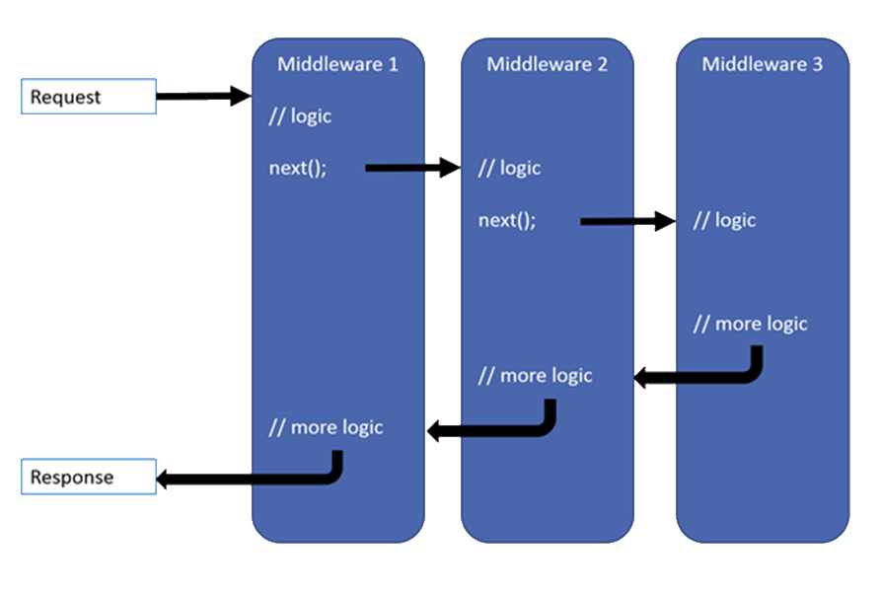
Middleware

Slide 9
Kestrel + Middlewares
Request
Middleware
next()
Middleware
Middleware
next()
Kestrel
return
return
Response
return

Slide 10


Data Access
.NET Core offers providers for Data Access on different platforms:
SQL Server / Azure SQL Database
PostgreSQL
SQLite
MySQL
No changes to the data access code
ADO.NET
Entity Framework
No data migration needed
Azure SQL Database
SQL Server
In cloud
On premise

Slide 11
Deploy
Xcopy deployment
On-premises
Azure - Windows or Linux VMs
Docker container
Windows container
You can use any of the deployment technology available on the corresponding OS (Windows / Linux / OS X)
.NET Core travels with the app
A machine-level .NET installation is not required, only the runtime.

Slide 12
Going to Production
Run it with a
reverse proxy
:80/:443
:5000
IIS – nginx – apache
IIS
Kestrel
Install ASP.NET Core Module first
My Web App
nginx
Apache

Slide 13
.NET yesterday—app models and libraries
.NET FRAMEWORK
.NET CORE
XAMARIN
APP
MODELS
WPF
Windows Forms
UWP
iOS
Android
ASP.NET
ASP.NET Core
OS X
BASE
LIBRARIES
Base Class Library
Core Library
Mono Class Library
COMMON INFRASTRUCTURE
Compilers
Languages
Runtime components
Notes:
Notes: Even if we are reusing a lot across components (especially with the open sourcing last year), the reality is that each platform has its own implementation of the base libraries.
Note: .NET Framework BCL and Mono BCL are the same APIs, different implementation. .NET Core “Core Library” is a similar set of APIs, but different.

Slide 14
.NET today
.NET FRAMEWORK
.NET CORE
XAMARIN
WPF
Windows Forms
UWP
iOS
Android
ASP.NET
ASP.NET Core
OS X
.NET STANDARD LIBRARY
One library to rule them all
COMMON INFRASTRUCTURE
Compilers
Languages
Runtime components
Notes:
Notes: Please welcome the .NET Standard Library [explain details]
As we move into the future we want to make it much easier for .NET developers to write their code once and be able to execute across .NET implementations, whether that’s .NET Framework, .NET Core, or Mono/Xamarin. To this end, we will continue to evolve and expand the .NET Standard into a set of APIs that are shared broadly across frameworks and application models. This will provide our ecosystem with much more explosive growth with libraries that can shared much more easily.

Slide 15
.NET Standard
.NET Standard is a specification that represents a set of APIs that all .NET platforms have to implement.
This unifies the .NET platforms and prevents future fragmentation.

Slide 16














Your platform for building anything
DESKTOP
WEB
CLOUD
MOBILE
GAMING
IoT
AI
.NET

Slide 17























Just a few of our millions of .NET customers… dot.net/customers
.NET mobile development with Xamarin "Xamarin allowed us to develop a single code base in C# and deploy the application to two completely different mobile phone ecosystems."
WPF on .NET Core 3.0 “.NET Core 3.0 allowed us to simplify our code and take advantage of modern Windows 10 APIs. Leveraging the Windows 10’s Bluetooth stack allowed us to drastically speed up development.“
Machine Learning with ML.NET “ML.NET made it straightforward to leverage our existing .NET and C# skills and software assets to add machine learning capabilities into the application… deployed on Azure, the integration of machine learning models was easy and straightforward.”
.NET Core microservices on Azure Kubernetes Service (AKS) “With .NET Core, our customers can now run the software on a wide spectrum of devices. It also gives us strong benefits with regard to operation costs in the cloud, because we can use it to run some workloads on Linux machines.”

Slide 18
.NET Growth continues
>1 million .NET Core developers
Visual Studio, Visual Studio for Mac, Visual Studio Code
Visual Studio
+1 million new monthly active .NET developers in last year

Slide 19
Open source momentum
Community PRs by month
19,000+ Community Contributions from 3700+ Companies outside Microsoft

Slide 20
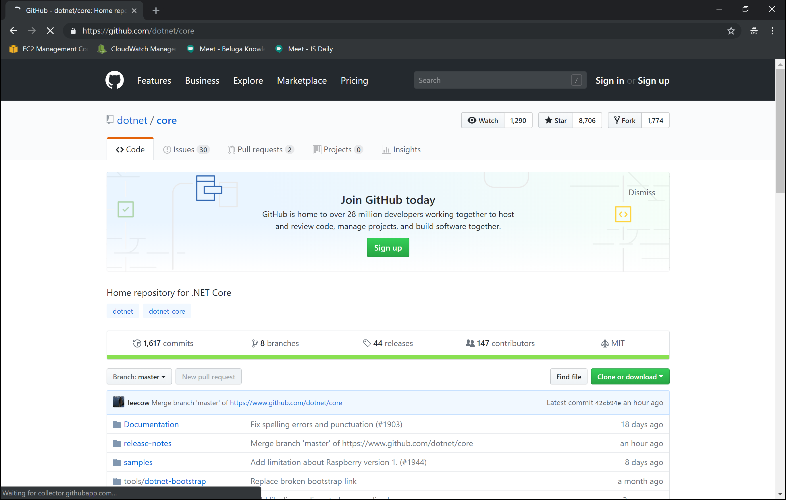
https://github.com/dotnet/core

Slide 21
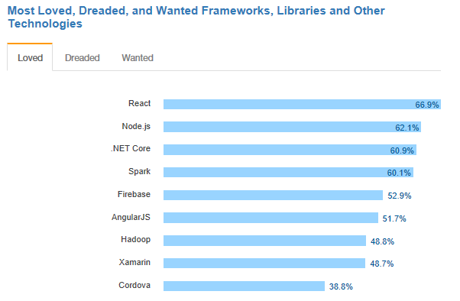
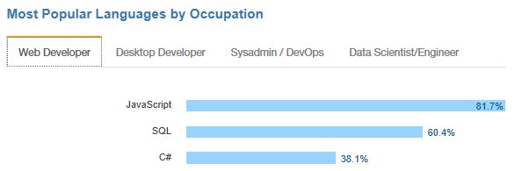
.NET is active and growing
.NET Core debuts at #3 most loved Framework on Stack Overflow Technology Survey 2017
C# is #3 most popular language for desktop and web developers on Stack Overflow Technology Survey 2017
Source: http://stackoverflow.com/insights/survey/2017

Slide 22
Guidance - .NET Architecture
Available now at: https://dot.net/architecture
eBooks & samples: Web, Containers, mobile
Patterns: Health checks, queueing
More books and patterns coming…

Slide 23
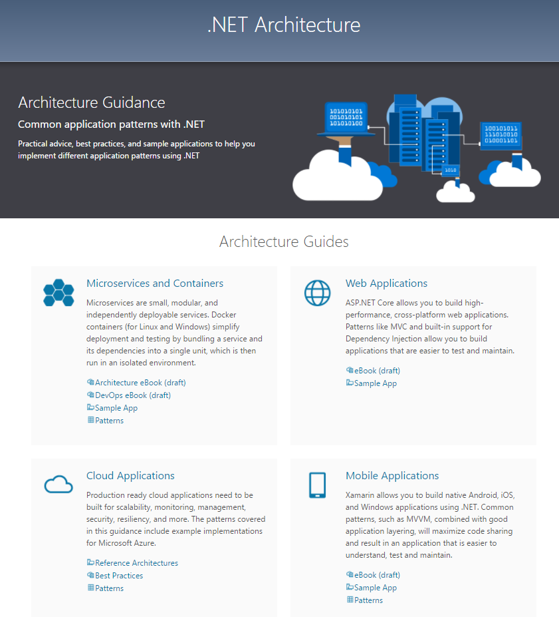

Slide 24

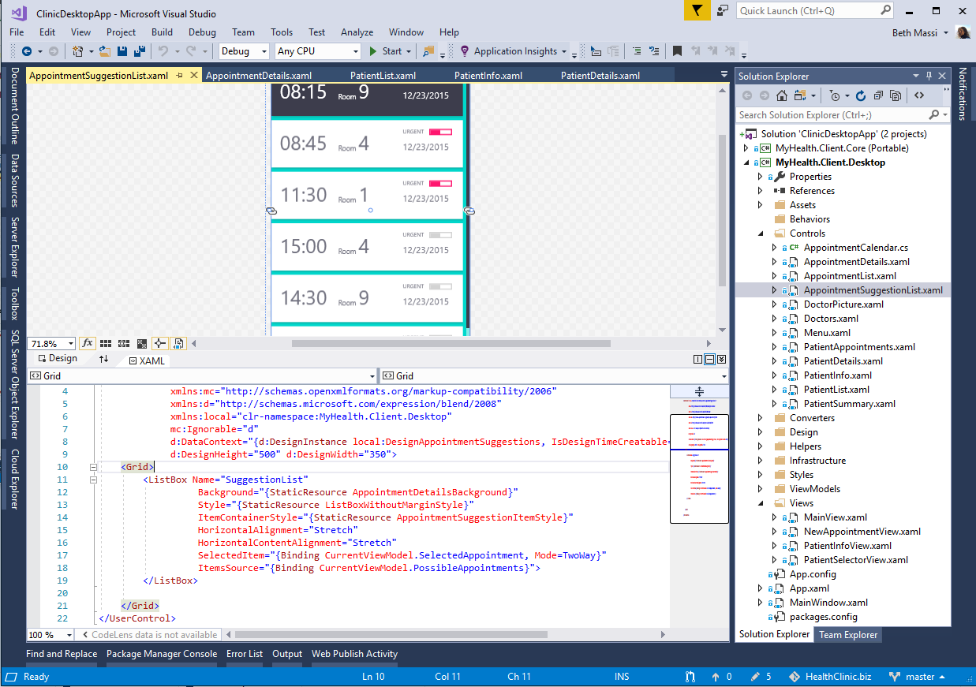
ANNOUNCING
.NET Core 3.0 preview 5
Windows desktop support with WPF and WinForms, also open source
Flexible deployment, side-by-side support and self-contained EXEs
Full-stack web development with C# and Razor
Significant performance improvements
New C# language features for productivity and less errors
dot.net/get-core3

Slide 25
The .NET Roadmap
Many
.NETs
2014
.NET FRAMEWORK
.NET CORE
XAMARIN / MONO
Runtime
Runtime
Runtime
Base class library
Core library
Mono class library

Slide 26
The .NET Roadmap
Many
.NETs
.NET
standard
2014
2016
.NET FRAMEWORK
.NET CORE
XAMARIN / MONO
Runtime
Runtime
Runtime
Base class library
Core library
Mono class library
.NET STANDARD

Slide 27
Introducing .NET 5
The .NET Roadmap
Many
.NETs
.NET
standard
.NET
2014
2016
Next
.NET FRAMEWORK
.NET CORE
.NET
XAMARIN / MONO
Runtime
Runtime
Runtime (JIT & native)
Runtime
Core library
Base class library
One base class library
Mono class library
.NET STANDARD

Slide 28
Introducing .NET 5
Supports all .NET application types
Evolution of .NET Core, adding the best of Mono into one unified platform
One BCL implementation, still adheres to .NET Standard
One toolchain (SDK style projects)
Both Just-in-Time (JIT) and native models supported
Interop with Java and Swift

Slide 29
What is not in .NET 5?
Web forms, WCF server and Windows workflow remain on .NET Framework 4.8 only. There are no plans to port these.
Recommendations
ASP.NET Blazor for ASP.NET Web forms (we will provide a migration guide)
gRPC for WCF server and remoting (we will provide a migration guide)
Open source core workflow for Windows workflow (WF): https://github.com/UiPath/corewf

Slide 30




.NET—A unified platform
TOOLS
DESKTOP
WEB
CLOUD
MOBILE
GAMING
IoT
AI
WPF
Windows forms
UWP
ASP.NET
Azure
Xamarin
Unity
ARM32
ARM64
ML.NET
.NET for Apache Spark
VISUAL STUDIO
.NET STANDARD
VISUAL STUDIO FOR MAC
.NET 5
VISUAL STUDIO CODE
INFRASTRUCTURE
RUNTIME COMPONENTS
COMPILERS
LANGUAGES
COMMAND LINE INTERFACE

Slide 31
.NET Schedule
July 2019
.NET Core 3.0
RC
Sept 2019
.NET Core 3.0
Nov 2019
.NET Core 3.1
LTS
Nov 2020
.NET 5.0
Nov 2021
.NET 6.0
LTS
Nov 2022
.NET 7.0
Nov 2023
.NET 8.0
LTS
.NET Core 3.0 release in September
.NET Core 3.1 = Long term support (LTS)
.NET 5.0 release in November 2020
Major releases every year, LTS for even numbered releases
Predictable schedule, minor releases if needed

Slide 32
Resources
.NET Core SDK
https://www.microsoft.com/net/core/
VS 2017 Update 3
https://www.visualstudio.com/vs/
.NET Architecture
https://www.microsoft.com/net/architecture
Editor Productivity & Refactoring Cheat Sheet
https://www.visualstudio.com/vs/net-productivity/

Slide 33
¿Preguntas?

Slide 34
¡ Gracias!
Mariano Sánchez
sanchezmariano@outlook.com @marianosz
http://weblogs.asp.net/marianos

